Slide 1
City of Brawley
FY24-25 Proposed Budget
Budget Study Session 2
June 4,2024

Slide 2
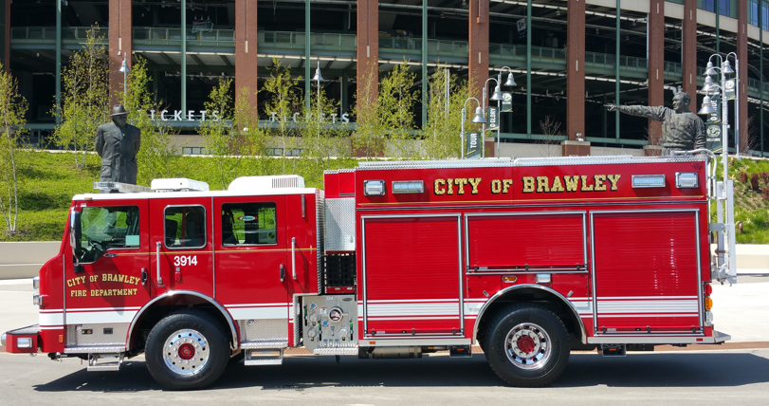
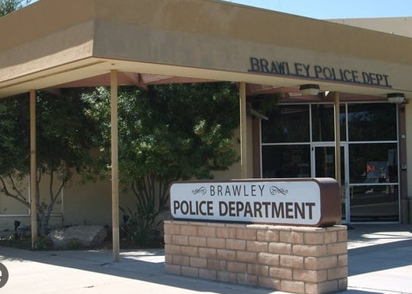
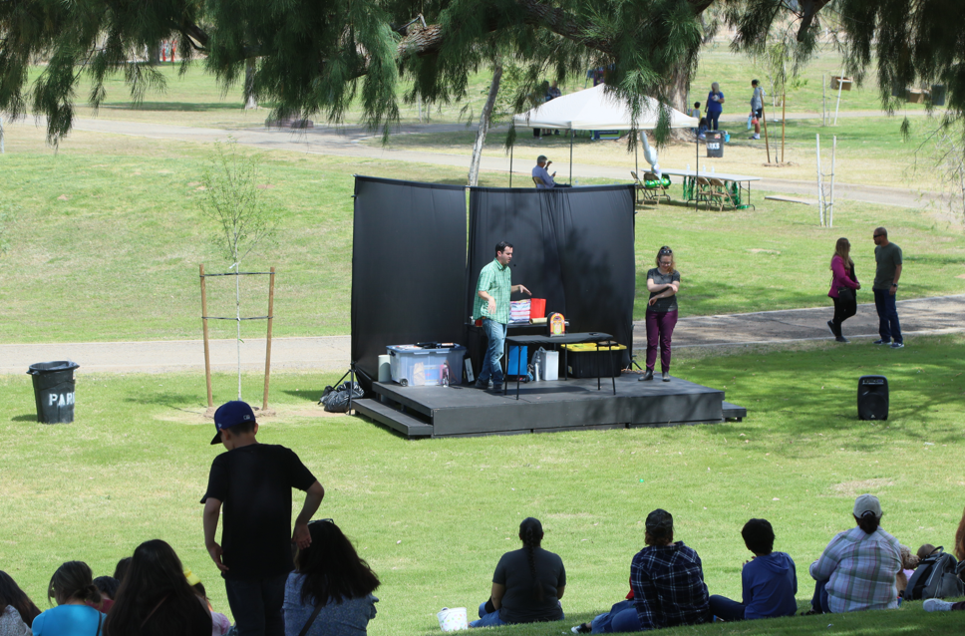
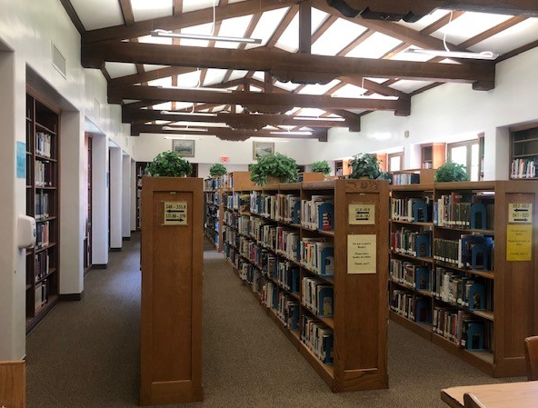
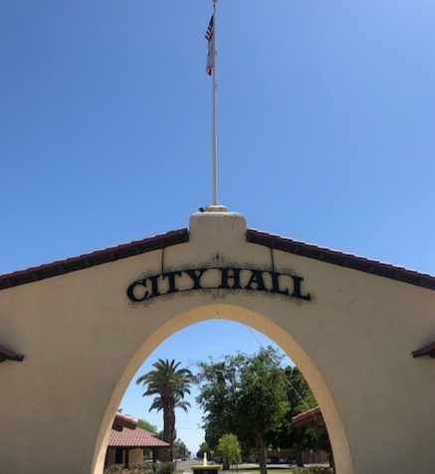
Today’s Presentation
Budget Study Session 2
FY24-25 Budget Timeline/Process
General Fund Budget Updates
Special Revenue Funds Overview
Enterprise Funds Overview
Q&A, Public Input, Direction
Next Steps: Budget Adoption, June 18, 2024.

Slide 3
FY2024/25 Budget Timeline
CIP Budget Overview
Budget Study Session 1
Budget Study Session 2
Budget Timeline
Budget Adoption
Tuesday, February 6, 2024
Regular Council Meeting
Tuesday, March 19, 2024
Regular Council Meeting
Tuesday, May 21, 2024
Regular Council Meeting
Tuesday, June 6, 2024
Regular Council Meeting
Tuesday, June 18, 2024
Regular Council Meeting
Study Session
Long-Term Strategic Planning
Budget Townhall
Wednesday, May 15, 2024
Virtual Townhall/Zoom
Operating & CIP
Tuesday, February 20, 2024
Regular Council Meeting
General Fund (Update)
General Fund ( Proposed)
Special Funds
Enterprise Funds

Slide 4
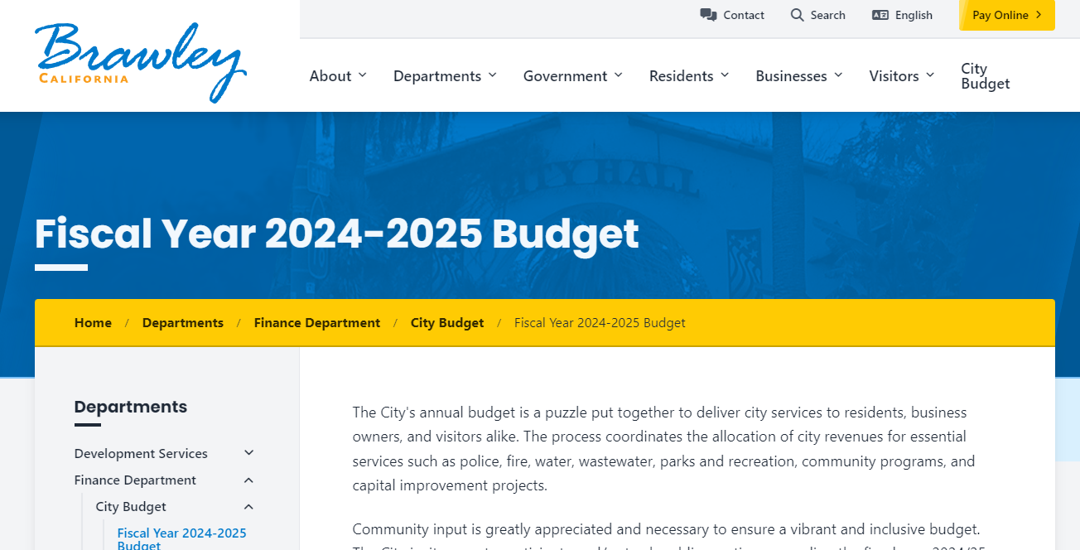
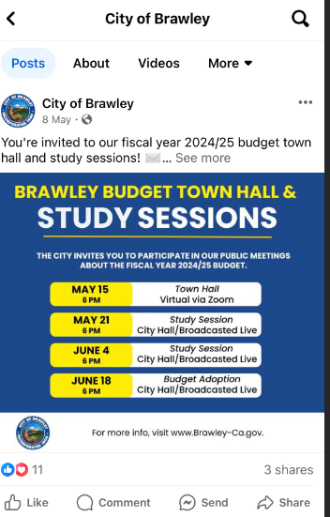
Stay Tuned
Dedicated budget website
Budget Workbook / Presentation slides available
Recorded Public meetings available during and after meetings
City Council Chambers starting at 6:00 PM

Slide 5
City-wide Budget 101
City-wide Operating and CIP Budget
General Fund
Streets Capital Projects
Enterprise
(1) Fund, (24) Departments:
Police
Graffiti Abatement
Fire
Animal Control
Code Enforcement
Parks & Recreation
Library
Community & Econ Development
City Administration
(4) Funds, (8) Departments:
Water
Wastewater
Solid Waste
Airport
(12 ) Streets Projects
$18.9M Budget
49 Funds
26.83 FTEs
(11) CIP & Heavy Equipment Projects
157 FTEs
118.25 FTEs
$ 18.1M Budget
Parks CIP
27%
43 CIP Projects
(7) CIP & Heavy Equipment Projects
(2) Parks Projects
2 Funds
11.7 FTEs
1%
39 Funds
$ 23M Budget
$180k Budget
.75 FTE
$2.2M
(11) CIP Projects
3%
$ 66.3 M Budget
35%
29%
5%

Slide 6
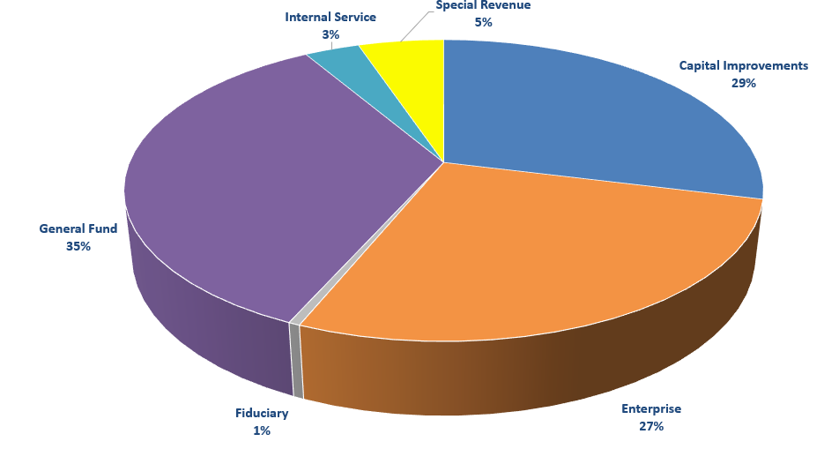
City-wide Budget 101
City-wide Operating and CIP Budget
49 Funds
157 FTEs
118.25 FTEs
43 CIP Projects
27%
2 Funds
$ 66.3 M Budget
$ 23M Budget
35%
3%
5%

Slide 7
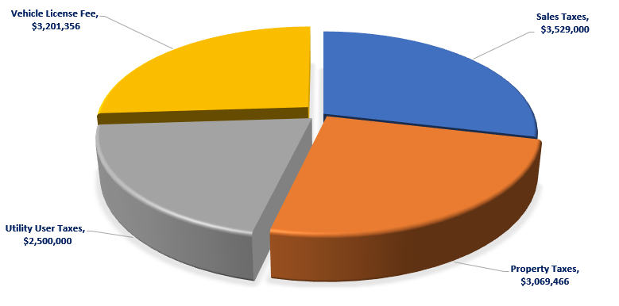
FY2024/25 General Fund
Revenues
Top 4 Tax Revenues = 54% of total GF Revenues
Revenue Category | 2023/24 Current Budget | 2024/25 Proposed | % Total | YOY Change
Taxes | 12,982,996 | 13,513,622 | 59% | 530,626
License & Permits | 282,400 | 324,100 | 1% | 41,700
Grants | 2,449,937 | 734,150 | 3% | -1,715,787
Fees & Charges | 5,281,128 | 6,459,786 | 28% | 1,178,659
Fines & Assessments | 13,000 | 17,000 | 0% | 4,000
Interest/Misc./Reim. | 1,119,022 | 247,150 | 1% | -871,872
Transfers In | 1,733,040 | 1,537,862 | 7% | -195,178
Total | 23,861,523 | $22,833,671 | 100% | $ -1,027,852
Grant Revenues adjusted to include revised Police Grant latest estimates = $ 35,000.
Moderate revenue projections
No major changes expected
Incorporated all known updates from the State, County, and other local agencies
Continuous monitoring is always recommended

Slide 8
FY2024/25 General Fund
Expenses Overview
Personnel Changes
Full-Time FTE’s
118.25
Added 4 FTEs
Utilities ( Price Increase
(CPUC Est. 1%- 2% )
FY2023/24 Carryovers
4% Cost of Living
(COLA, 2021 MOU)
Inflationary Impact Supplies & Services
Facility Improvements (ADA, Parks)
Library Improvements/+Other
$800K
Merit Increases
(Applicable Employees)
Professional and Technical Services
( Multi-year Contracts)
New & Current Software , Hardware, Licenses
Maintenance
Pension and Medical Plans Price Increases
New Vehicle Leases
+ 4 new 60 mo. leases
General Fund Allocations ( WC, Insurance, POB)
Proposed Budget 2

Slide 9
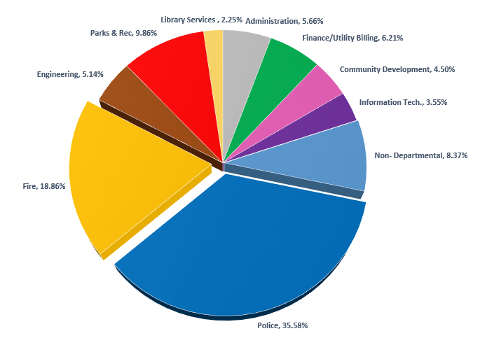
FY2024/25 General Fund
Expenses
Department | 2024/25 Proposed 2 | % Total
Administration | 1,308,144 | 5.66%
Finance/Utility Billing | 1,435,428 | 6.21%
Community Development | 1,039,245 | 4.54%
Information Tech. | 819,756 | 3.55%
Non- Departmental | 1,933,088 | 8.37%
Police | 8,219,323 | 35.58%
Fire | 4,356,897 | 18.86%
Engineering | 1,187,717 | 5.14%
Parks & Rec | 2,278,469 | 9.86%
Library Services | 520,551 | 2.25%
Total Expenses | 23,098,618 | 100%
Salaries & Benefits …………………………………………………+ $ 219,609
Temporary Salaries ……………………………………………….. + $ 47,680
Travel & Training …………………………………………………… + $ 2,500
Technical Services …………………………………………………. + $ 16,356
Professional Services………………………………………………+ $ 112,288
Software & Subscriptions………………….…..………………. + $ 24,475
Other Operating Supplies- Events…………………………… +$ 15,000
Postage …………………………………………………………………..+$ 4,000
New Vehicle Leases………………………………………………….+$ 29,162
Furniture & Equipment ………………….………………………..+$ 37,000
Parks & Rec CIP………………………………………………………..+$ 198,000
NET FISCAL IMPACT $706,070

Slide 10
FY2024/25 General Fund
Pending Budget Requests
Dispatcher
FTE
Fiscal Impact $ 73,887
Parks Equipment Repair/Replacement
Fiscal Impact $180,000
New- 1 Vehicle Lease Engineering
Fiscal Impact $ 4,847
Total Fiscal Impact
Pending Items
$ 104,000
Firefighter
(1) FTE
Fiscal Impact $ 85,782
Police Department Employee Parking lot- pavement
Fiscal Impact $104,000
New- 1 Vehicle Lease Parks
Fiscal Impact $ 8,743
Literacy Clerk
( Grant Funded)
(1) FTE
Fiscal Impact $ 55,372
New- 2 Vehicle Leases
Police
Fiscal Impact $ 15,573
City-wide ADA Assessment
Fiscal Impact $112,288
PT- Parks General Laborer (<900 hrs.)
Fiscal Impact $ 15,502

Slide 11
FY2024/25 General Fund
Reserves Overview
Fund Balance Category | Estimated at 06/30/2024 | Anticipated Surplus/Shortfall | Estimated at 06/30/2025
Non-spendable ( prepaids) | 35,711 |  | 35,711
Restricted for Library | 48,736 | - | 48,736
Committed to Operational Carryovers | 800,000 |  | 500,000
Committed to Capital Repl. Reserves | 800,000 | 100,000 | 900,000
Public Safety Personnel Reserve | 300,000 | 100,000 | 400,000
Unassigned | 4,996,590 | (464,947) | 4,531,643
TOTAL FUND BALANCES | $6,981,037 | (264,947) | $ 6,416,090
General Fund Fiscal Overview- Proposed Budget
Revenues | $22,833,671
Expenses | $23,098,618
Budget Surplus/(Deficit) | ( 264,947)
RESERVE TARGET CALCULATION - (15% of Expenses)
FY 2024/25 Expenses at Budget Adoption | 15% Target | Estimated at 6-30-2025 | Surplus/ (Shortfall)
$23,098,618 | $3,464,793 | $4,531,643 | $1,066,851

Slide 12
FY2024/25 Special Funds
Overview
Special Revenue Fund -Type | Revenues | Expenses | Surplus/(Deficit )
Economic Development ( 5 Funds) | 36,525 | 27,200 | 9,325
Special Revenue – Police Grants/ARPA ( 8 Funds) | 3,252,893 | 3,322,933 | (70,040)
Community Facility Districts (7 Funds) | 697,824 | 291,407 | 406,417
Development Impact Fees/Capacity Fees (10 Funds) | 700,850 | 210,210 | 490,640
Public Transportation & Pedestrian ( 2 Funds) | 43,073 | 147,510 | (104,437)
Streets Funding ( 4 Funds) | 3,695,343 | 2,125,994 | 1,569,349
Total Special Revenue ( 39 Funds) | $ 8,426,508 | $ 6,125,254 | $ 2,301,254.00
No major changes expected
Incorporated all operational needs based on department input
Incorporated all known updates from the State, County, and other local agencies
Deficits are covered by fund balance (savings or the pledge of future revenues)
Continuous monitoring is always recommended

Slide 13
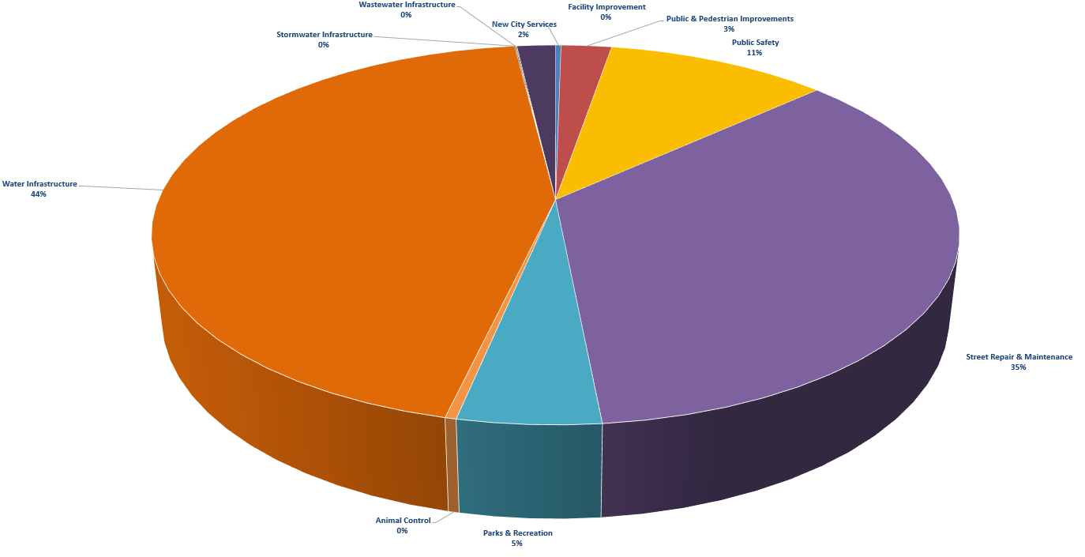
FY2024/25 Special Funds
Overview
Special Revenue Usage
Restricted Funds = Specific and limited
11.7 FTEs
11 CIP Projects
$6.1M Budget

Slide 14
FY2024/25 Enterprise Funds
Overview
Enterprise Fund | EFTs | Revenues | Expenses | Surplus/(Deficit)
Water | 15.9 | 7,792,000 | 8,809,142 | (1,017,142)
Wastewater | 9.88 | 6,893,000 | 7,043,182 | (150,182)
Solid Waste | 0.75 | 1,850,600 | 2,114,656 | (264,056)
Airport | 0.3 | 147,620 | 165,812 | (18,192)
TOTAL | 26.83 | $16,683,220 | $18,132,792 | $(1,449,572)
No major changes expected
Incorporated all operational needs based on department input
Incorporated all known updates from the State, County, and other local agencies
Deficits are covered by fund balance (savings or the pledge of future revenues)
Continuous monitoring is always recommended

Slide 15
FY2024/25 General Fund
Q&A + Direction
Questions & Answers
Receive Direction – Proposed changes for Final Budget– Session of June 18, 2024

Slide 16
Next Steps
FY2024/25 Budget
Continue to evaluate funding sources
Continue to refine cost estimates
Incorporate any changes from tonight's discussion
Next meeting – Budget Adoption: June 18, 2024
Budget
This Photo by Unknown Author is licensed under CC BY-NC

Slide 17
THANK YOU!
For more information on the FY2024-25 Budget :
www.brawley-ca.gov
Finance@brawley-ca.gov
(760) 344-8941
400 Main St, Brawley CA
We are on social media! Follow us on:

